Slide 1
Lane Detection
Day 2 - Morning Session 1

Slide 2
Image Pixels
Pixel is considered the “color” or the “intensity” of light that appears in a given place in our image.
Range of 0 to 255
Pixels are represented in two ways:
Grayscale/Single channel
Color

Slide 3
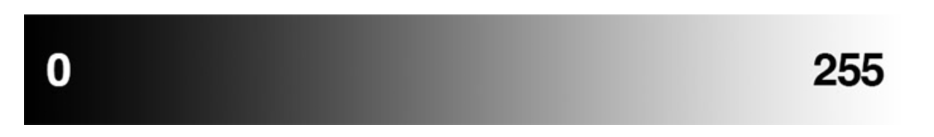
Grayscale/Single channel
Each pixel has value between 0 and 255 where "0" corresponds to black and "255" being white

Slide 4
Color(RGB/HSV/HSL)
RGB
Each of the red, blue, green channel is represented by integer.
[255,255,255] is white color
[0,0,0] is black color
[255,0,0] is pure red color
[0,0,255] is pure blue color
https://www.w3schools.com/colors/colors_rgb.asp

Slide 5
Color
HSV
Hue is the color portion of the model, expressed as a number from 0 to 360 degrees.
Saturation describes the amount of gray in a particular color, from 0 to 100 percent. Reducing this component toward zero introduces more gray and produces a faded effect.Value describes the brightness or intensity of the color, from 0 to 100 percent, where 0 is completely black, and 100 is the brightest and reveals the most color.
For HSV, Hue range is [0,179], Saturation range is [0,255] and Value range is [0,255]
https://math.hws.edu/graphicsbook/demos/c2/rgb-hsv.html
https://opencv24-python-tutorials.readthedocs.io/en/latest/py_tutorials/py_imgproc/py_colorspaces/py_colorspaces.html

Slide 6
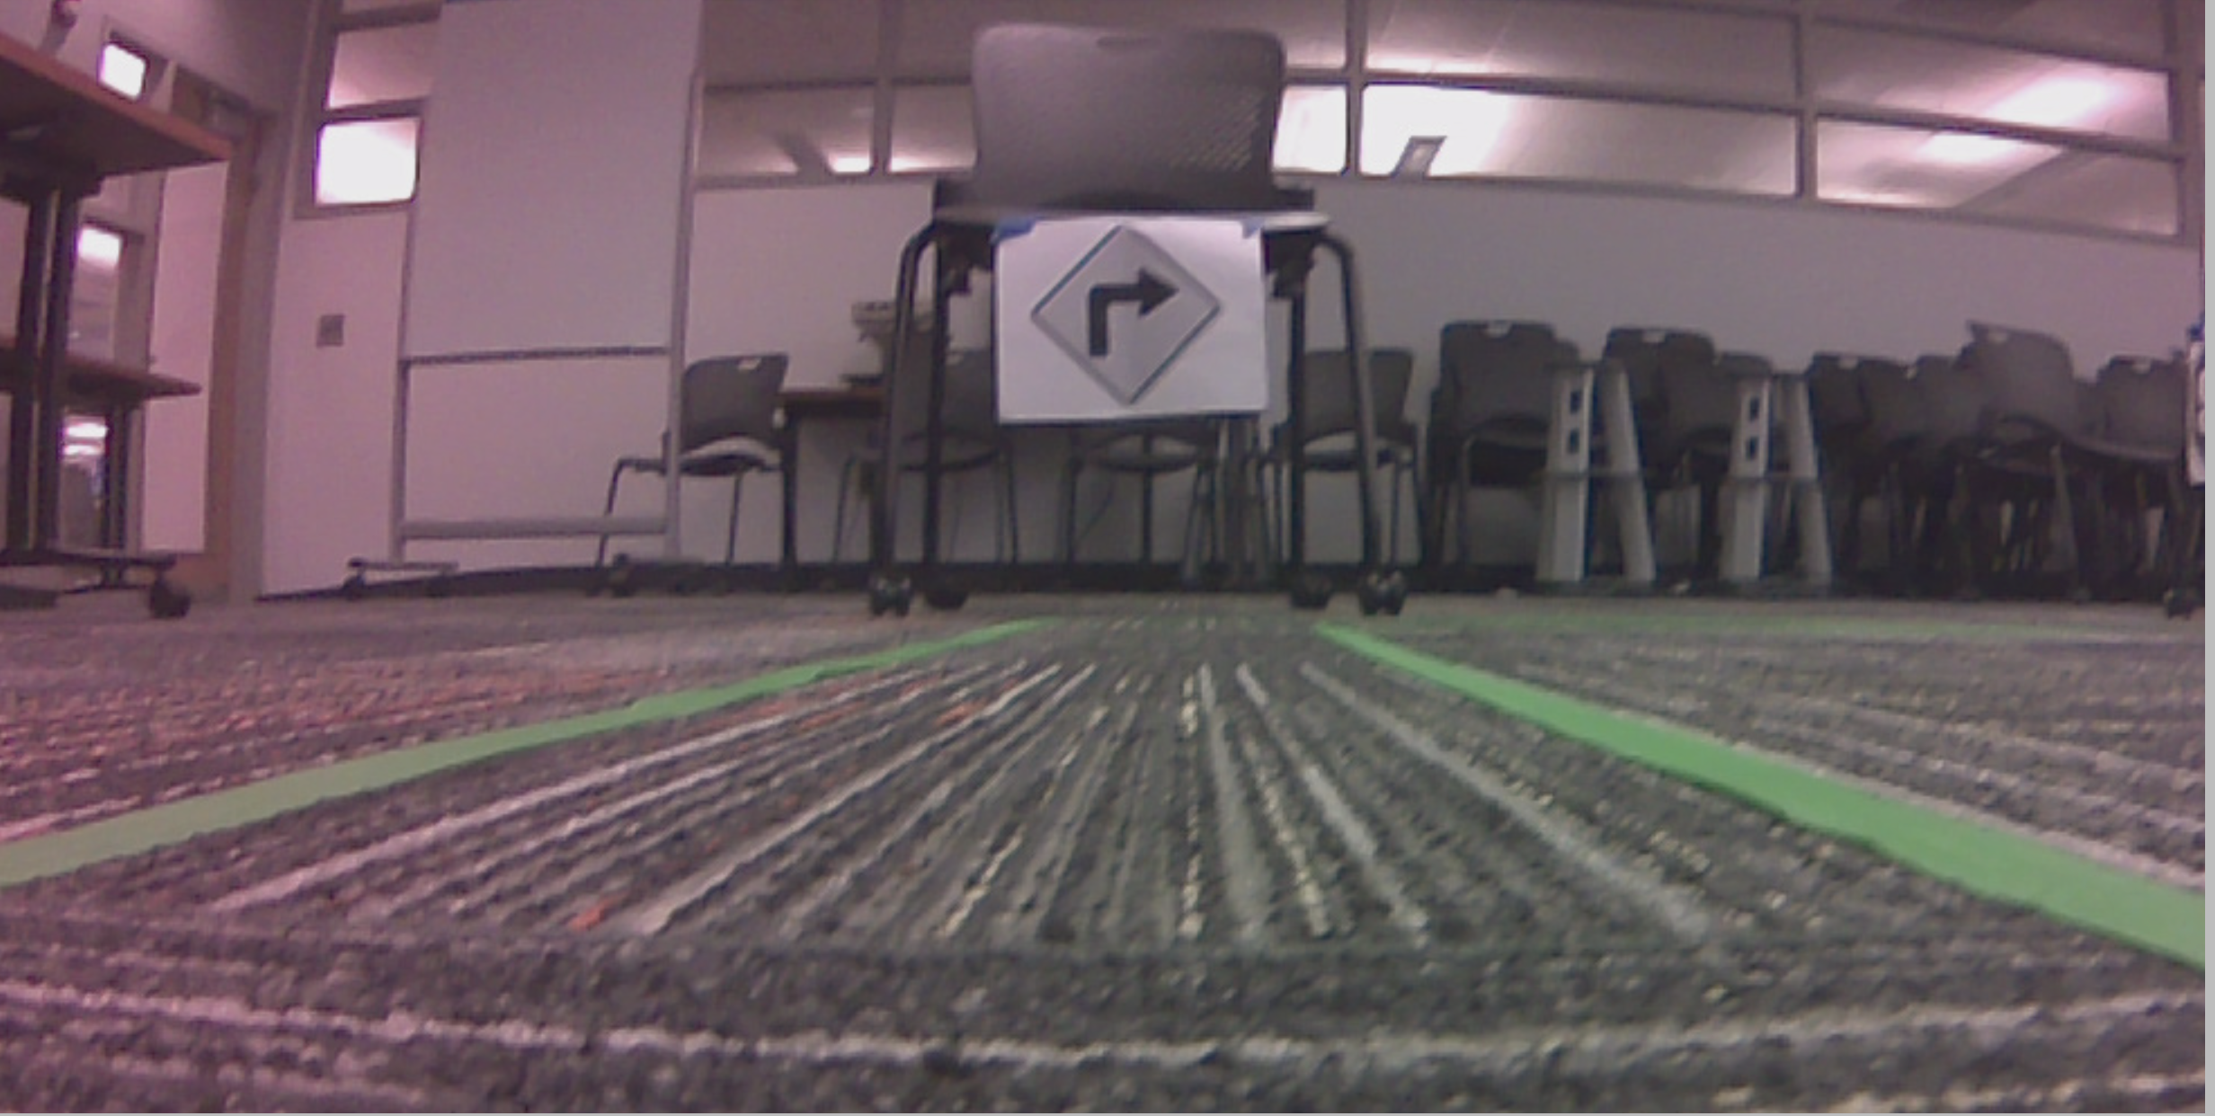

Slide 7
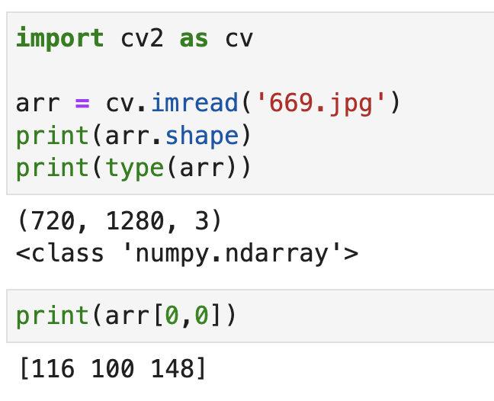
Image Size

Slide 8
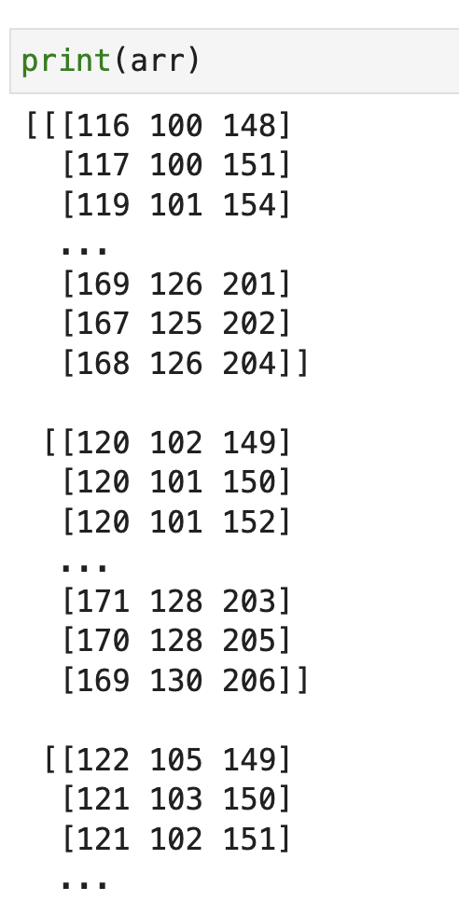
Image Array

Slide 9
Image Distortion
Some pinhole cameras introduce significant distortion to images.
Two major kinds of distortion:
Radial distortion
Tangential distortion
Reference: https://medium.com/@vivanraaj/perception-in-self-driving-cars-part-1-1ccca42b169

Slide 10
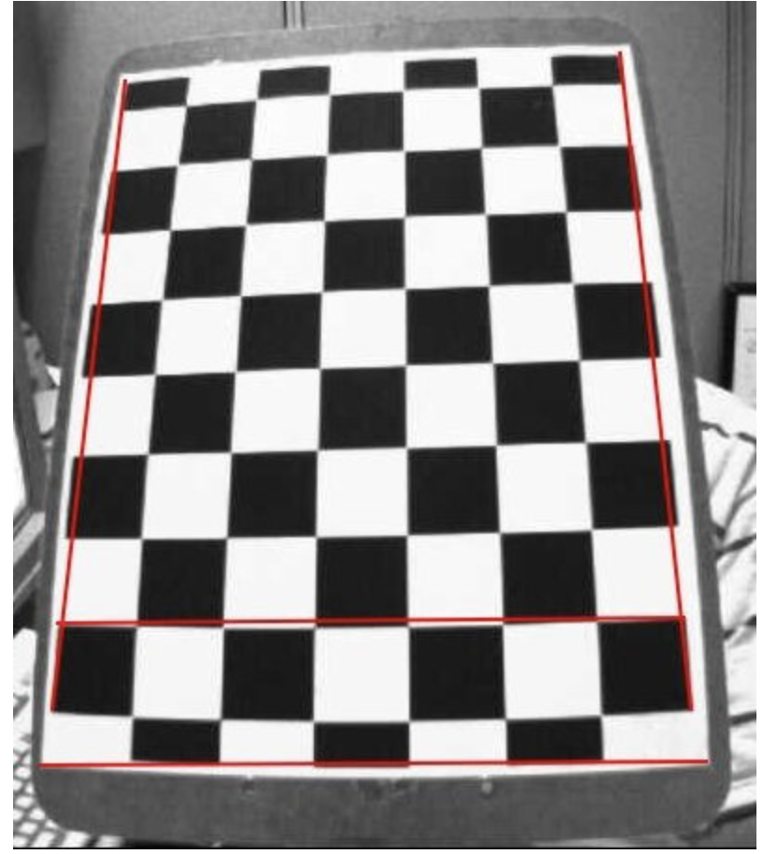
Radial Distortion
Cause straight lines to be appear curved
Becomes larger the farther points are from the center of the image

Slide 11
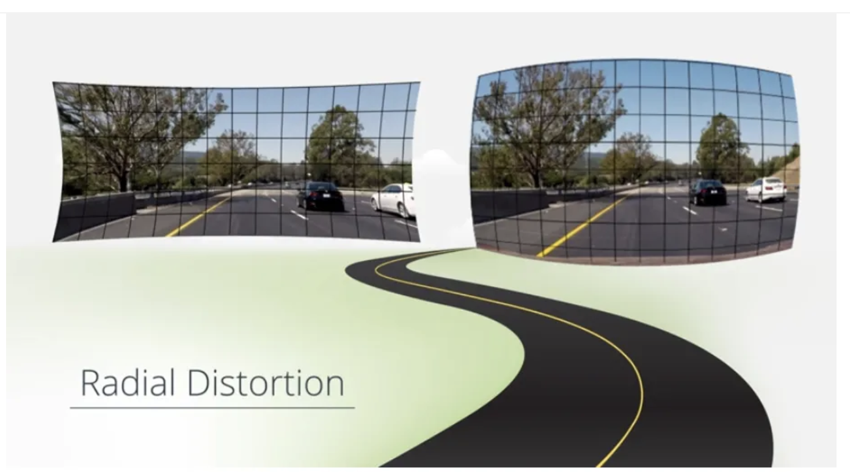
Radial Distortion

Slide 12
Tangential Distortion
Occurs when the image-taking lense is not aligned perfectly parallel to the imaging plane
Some areas in the image may look nearer than expected.

Slide 13
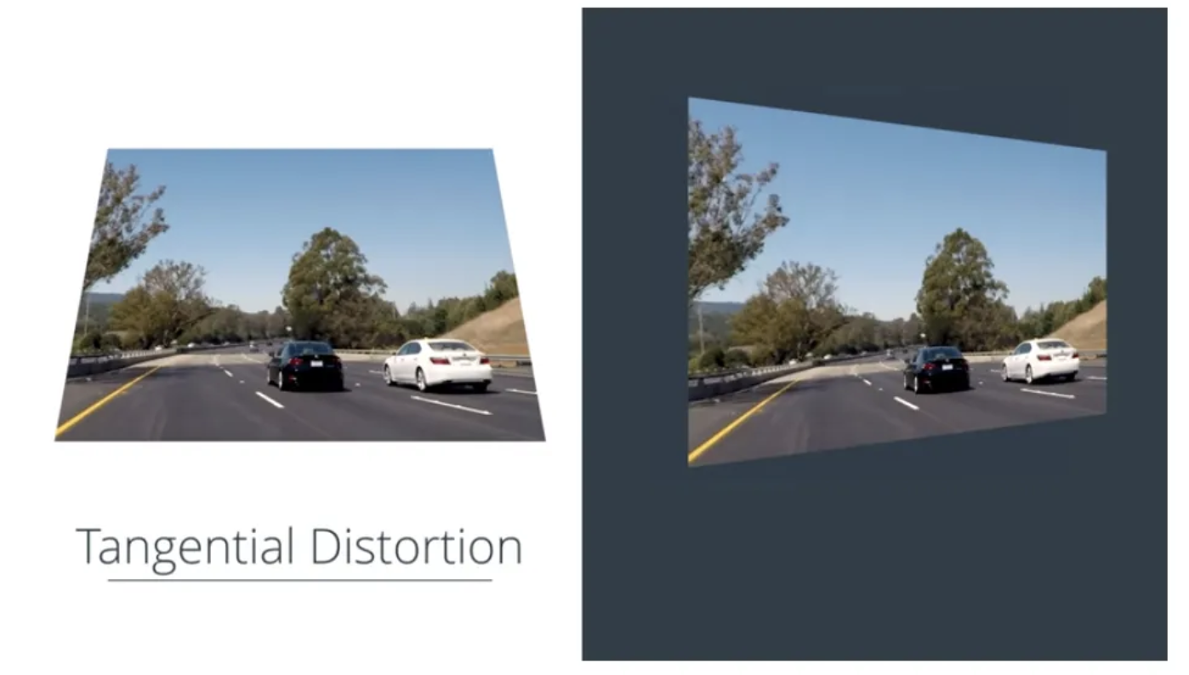
Tangential Distortion

Slide 14
Region of Interest
Portion of an image that you want to filter or operate on in some way.
You can represent an ROI as a binary mask image.
In the mask image, pixels that belong to the ROI are set to 1 and pixels outside the ROI are set to 0 .

Slide 15
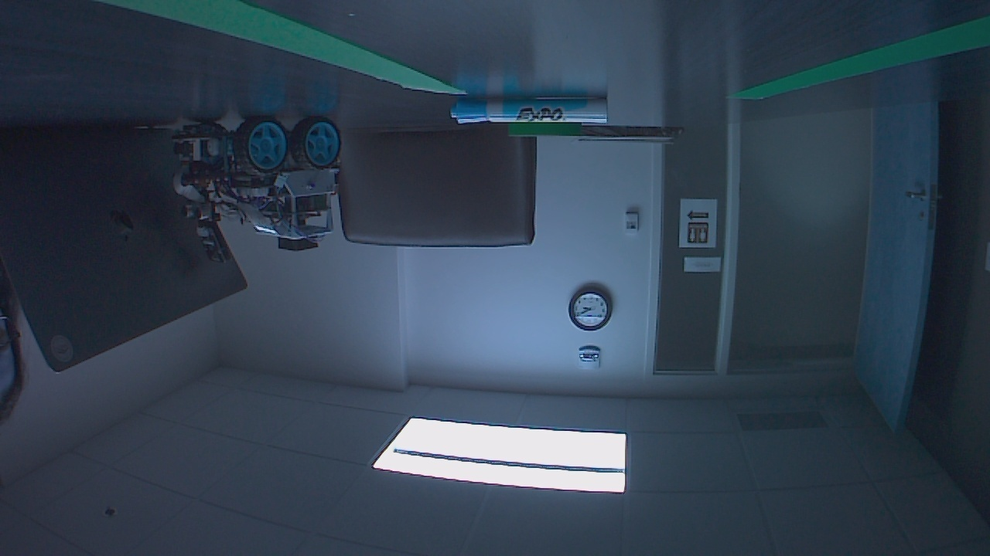
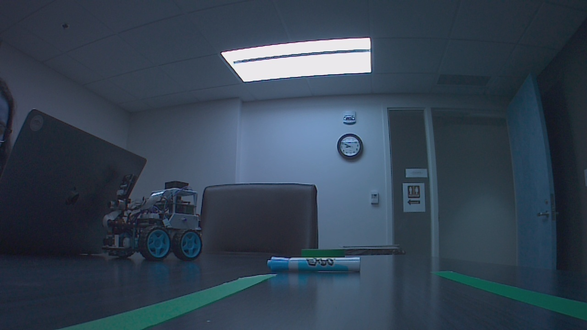
Original Image and Flipped Image

Slide 16
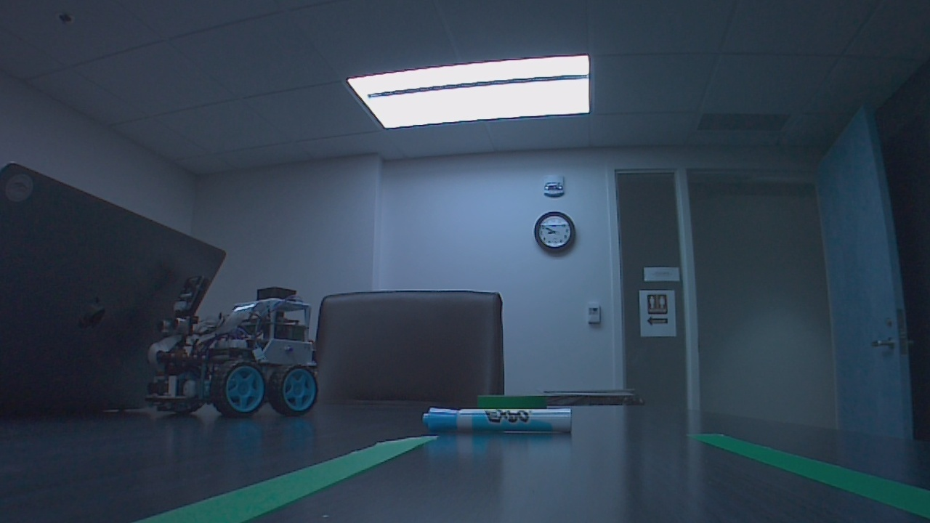
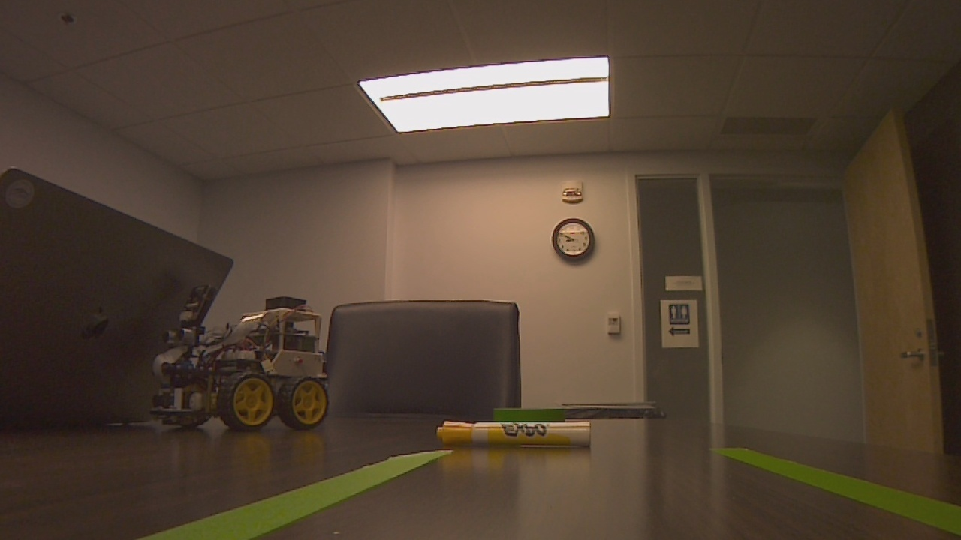
Undistorted Image and RGB image

Slide 17
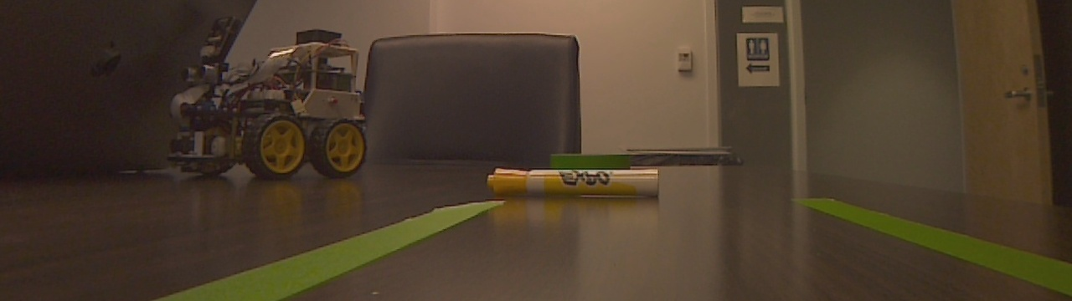
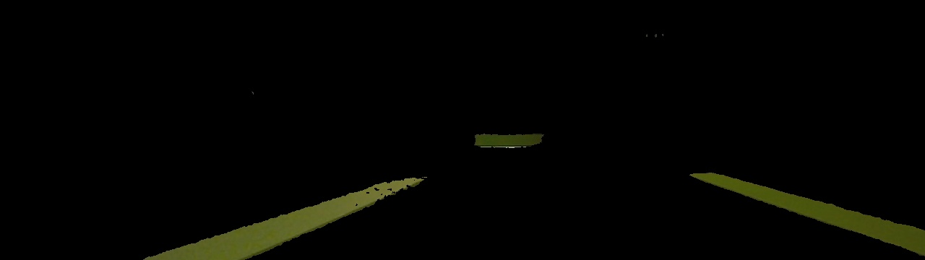
ROI Image and Green mask Image

Slide 18
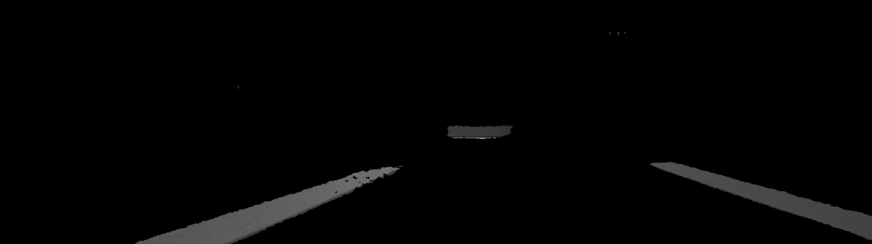
Grayscale Image

Slide 19
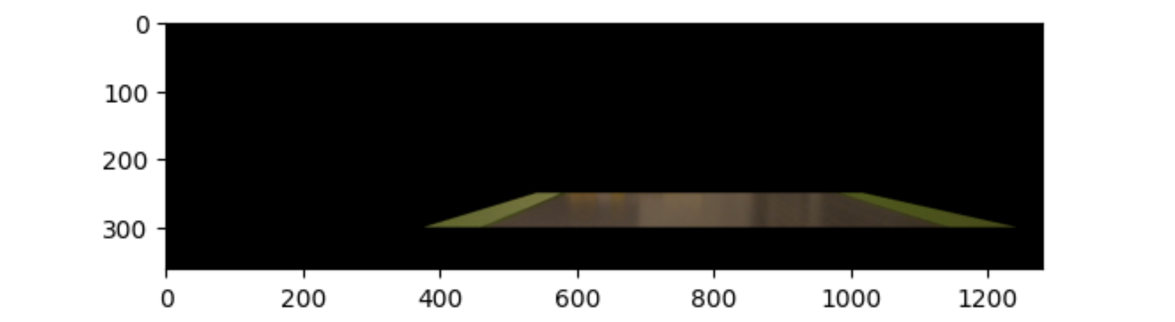
Final X and Y value

